Slide 1
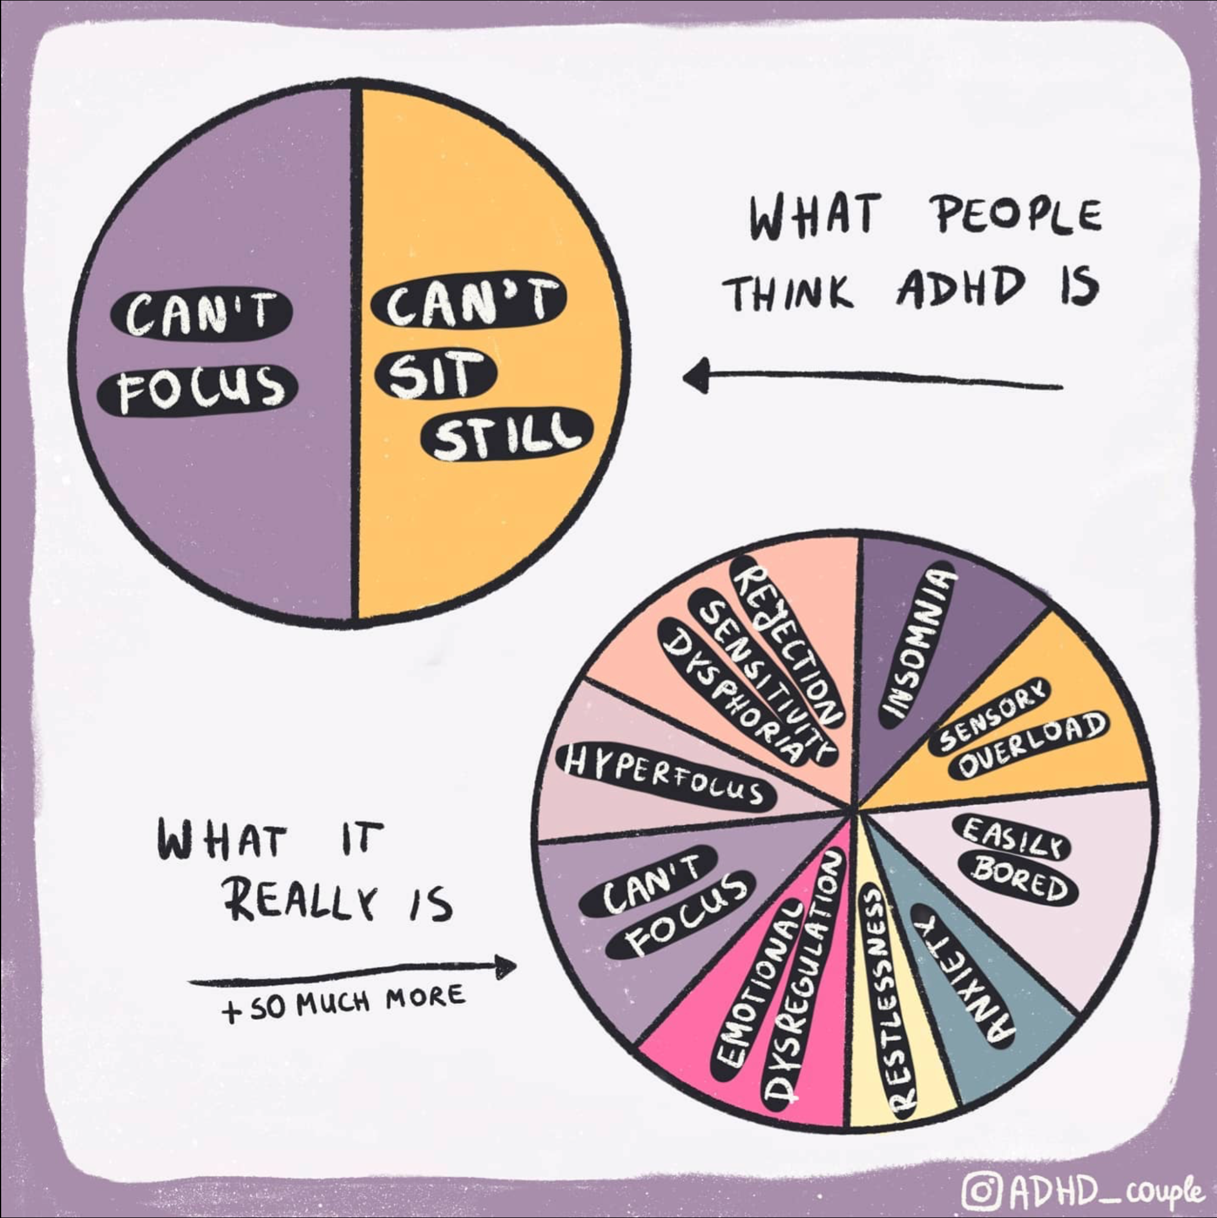
Understanding
ADHD
In Memes!
Dr Shelley Braude
Please note: The memes and videos shared in this presentation are not my intellectual property and I do not have the copyrights for them, but as it is neither for profitable or commercial purposes, the internet says it is ok to use them!
Notes:
Rejection Sensitivity Dysphoria
Insomnia
Sensory Overload
Easily (and painfully) bored
Anxiety
Restlessness
Emotional Dyregulation
Can’t focus- and Hyper focus.

Slide 2
Overview
Part One
Define ADHD
Explain the neurological basis for ADHD- structure and neurotransmitters
Talk through the presentation of ADHD in practice
Part Two
Share some of the ADHD Superpowers
Explore Strategies for supporting learners and colleagues with ADHD
Time for Questions… hopefully!

Slide 3
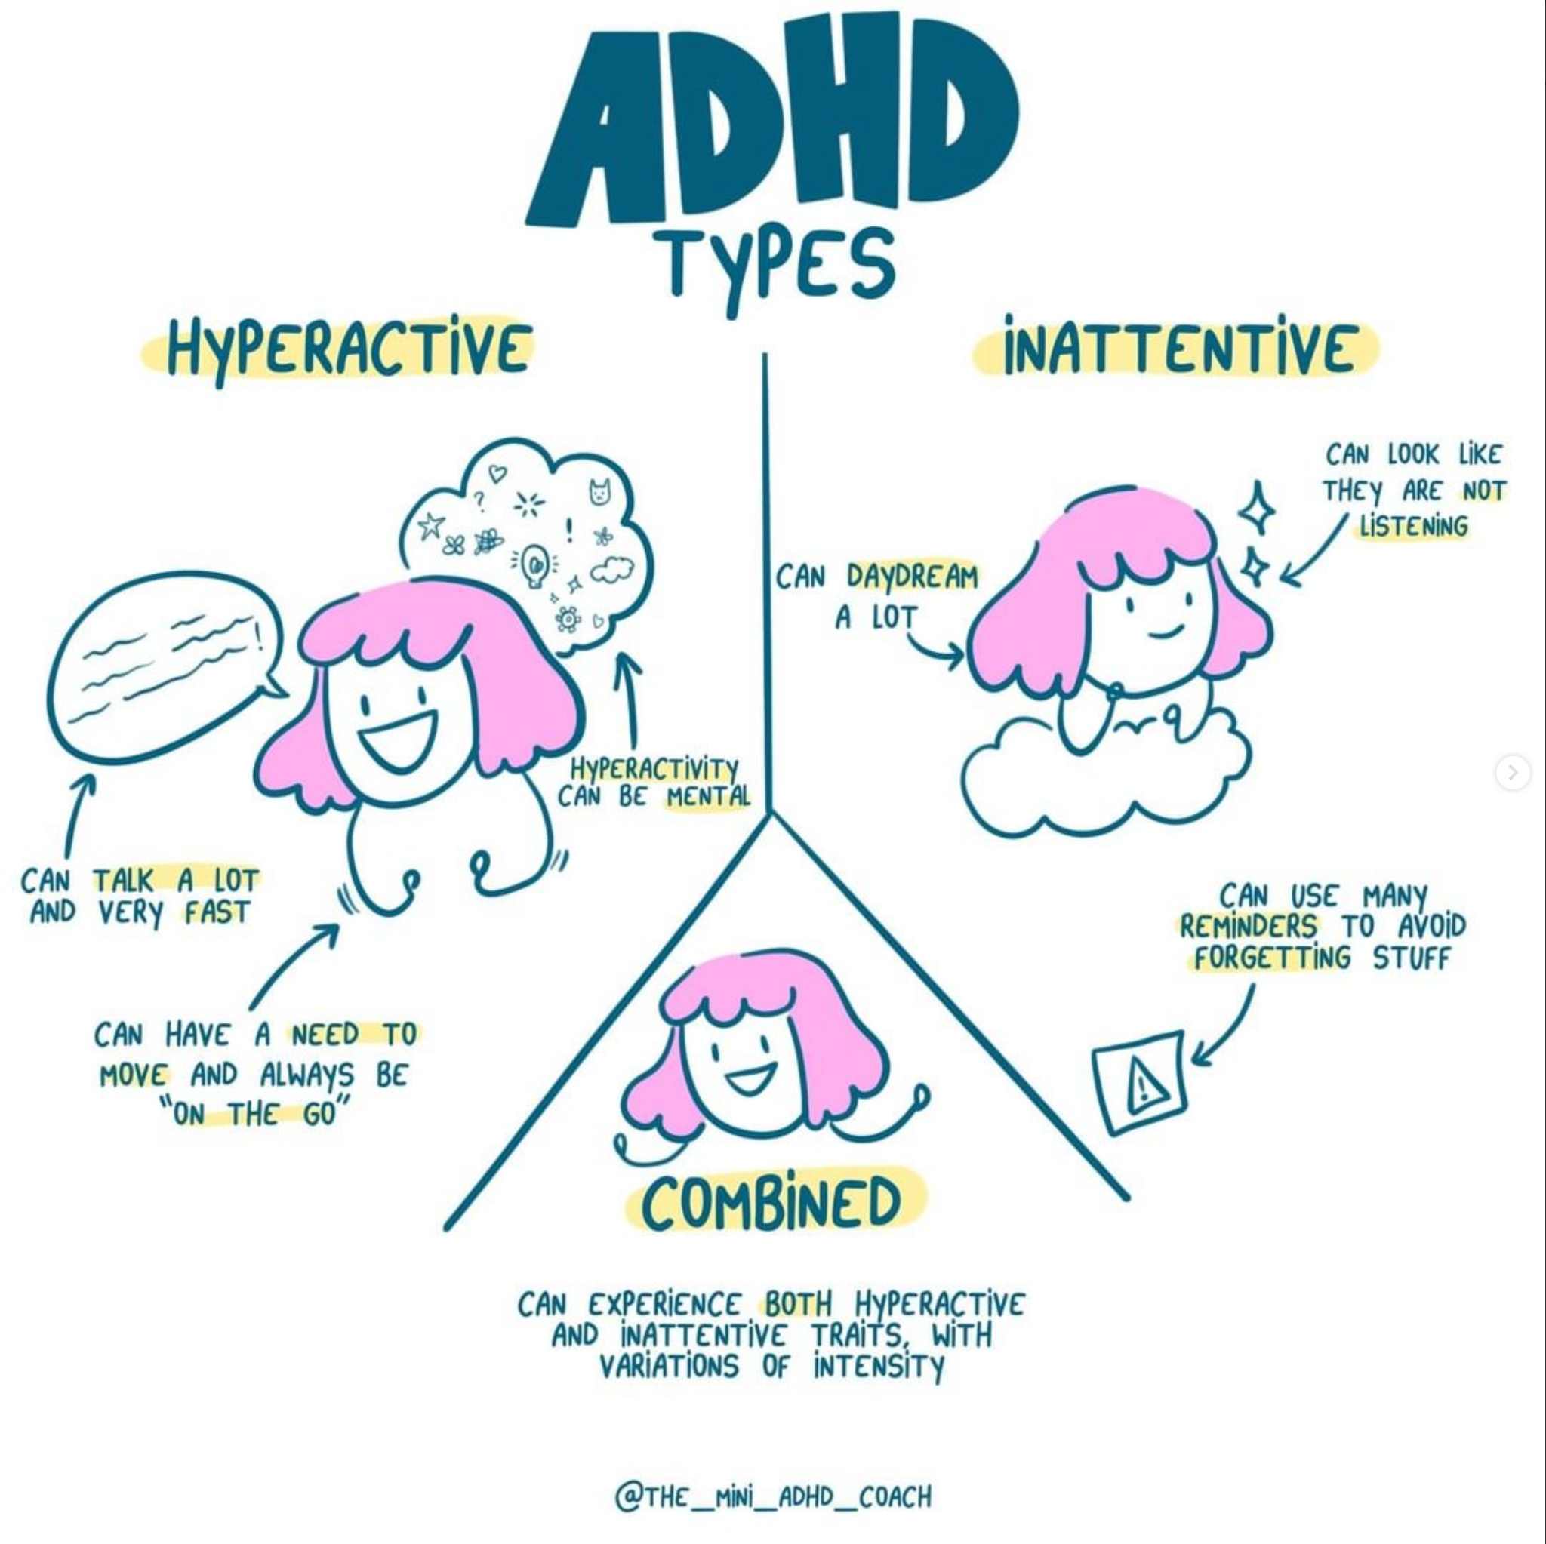
The Technical Stuff
ADHD is a medical diagnosis characterised by:
Inattention
Hyperactivity
Impulsivity
3 presentations in the ICD10 and DSM-V:
Notes:
There are 3 types
Predominantly Inattentive Type: Formerly known as ADD (Attention Deficit Disorder). Characterised by difficulties with the attentional system, focus, concentration and staying on task being the most significant impairments and not usually presenting with difficulties as a result of physical hyperactivity or impulsivity.
Hyperactive/ Impulsive type: Difficulties with impulse control and physical and mental hyperactivity being the most significant impairments and not usually presenting with difficulties as a result of attentional dysregulation. (hyperactivity can sometimes include hypervigilance which can appear to be inattention: https://www.tiktok.com/@adhd_love/video/7059308519379586310)
Combined type: Difficulties in all 3 ares: Inattention, physical and mental hyperactivity and impulsivity.
More recent research suggests that the majority of those with ADHD fall into the combined type.

Slide 4
Hyperactive and impulsive type ADHD- Need 6 or more:
Often fidgets with or taps hands or feet or squirms in seat.
Often leaves seat in situations when remaining seated is expected.
Often runs about or climbs in situations where it is inappropriate. (Note: In adolescents or adults, this may manifest as feeling restless.)
Often unable to play or engage in leisure activities quietly.
Is often unable to remain still for any extended time without significant discomfort; others may say the patient is restless, fidgety, or difficult to keep up with.
Often talks excessively.
Often blurts out an answer before a question has been completed (e.g. completes people’s sentences).
Often has difficulty waiting his or her turn (e.g., while waiting in line, while speaking in conversations).
Often interrupts or intrudes on others (e.g. butts into conversations, games, or activities; may start using other people’s things without asking or receiving permission; for adolescents and adults, may intrude into or take over what others are doing).

Slide 5
ADHD Inattentive Type- Need at least 6
Often fails to give close attention to details or makes careless mistakes in schoolwork, at work, or during other activities (e.g., overlooks or misses details, turns in inaccurate work).
Often has difficulty sustaining attention in tasks or play activities (e.g., lectures, conversations, reading).
Often does not seem to listen when spoken to directly (e.g., mind seems elsewhere, even in the absence of any obvious distraction).
Often does not follow through on instructions and fails to finish schoolwork, duties, tasks.
Often has difficulty organizing tasks and activities (e.g., struggle to manage sequential tasks, keep materials and belongings in order, organise work, manage time, and meet deadlines).
Often avoids, dislikes, or is reluctant to engage in tasks that require sustained mental effort.
Often loses things necessary for tasks or activities (e.g., school materials, pencils, books, tools, wallets, keys, paperwork, eyeglasses, mobile telephones).
Is often easily distracted by extraneous stimuli (including unrelated thoughts).
Is often forgetful in daily activities (e.g., paying bills, errands, returning calls, keeping appointments).

Slide 6
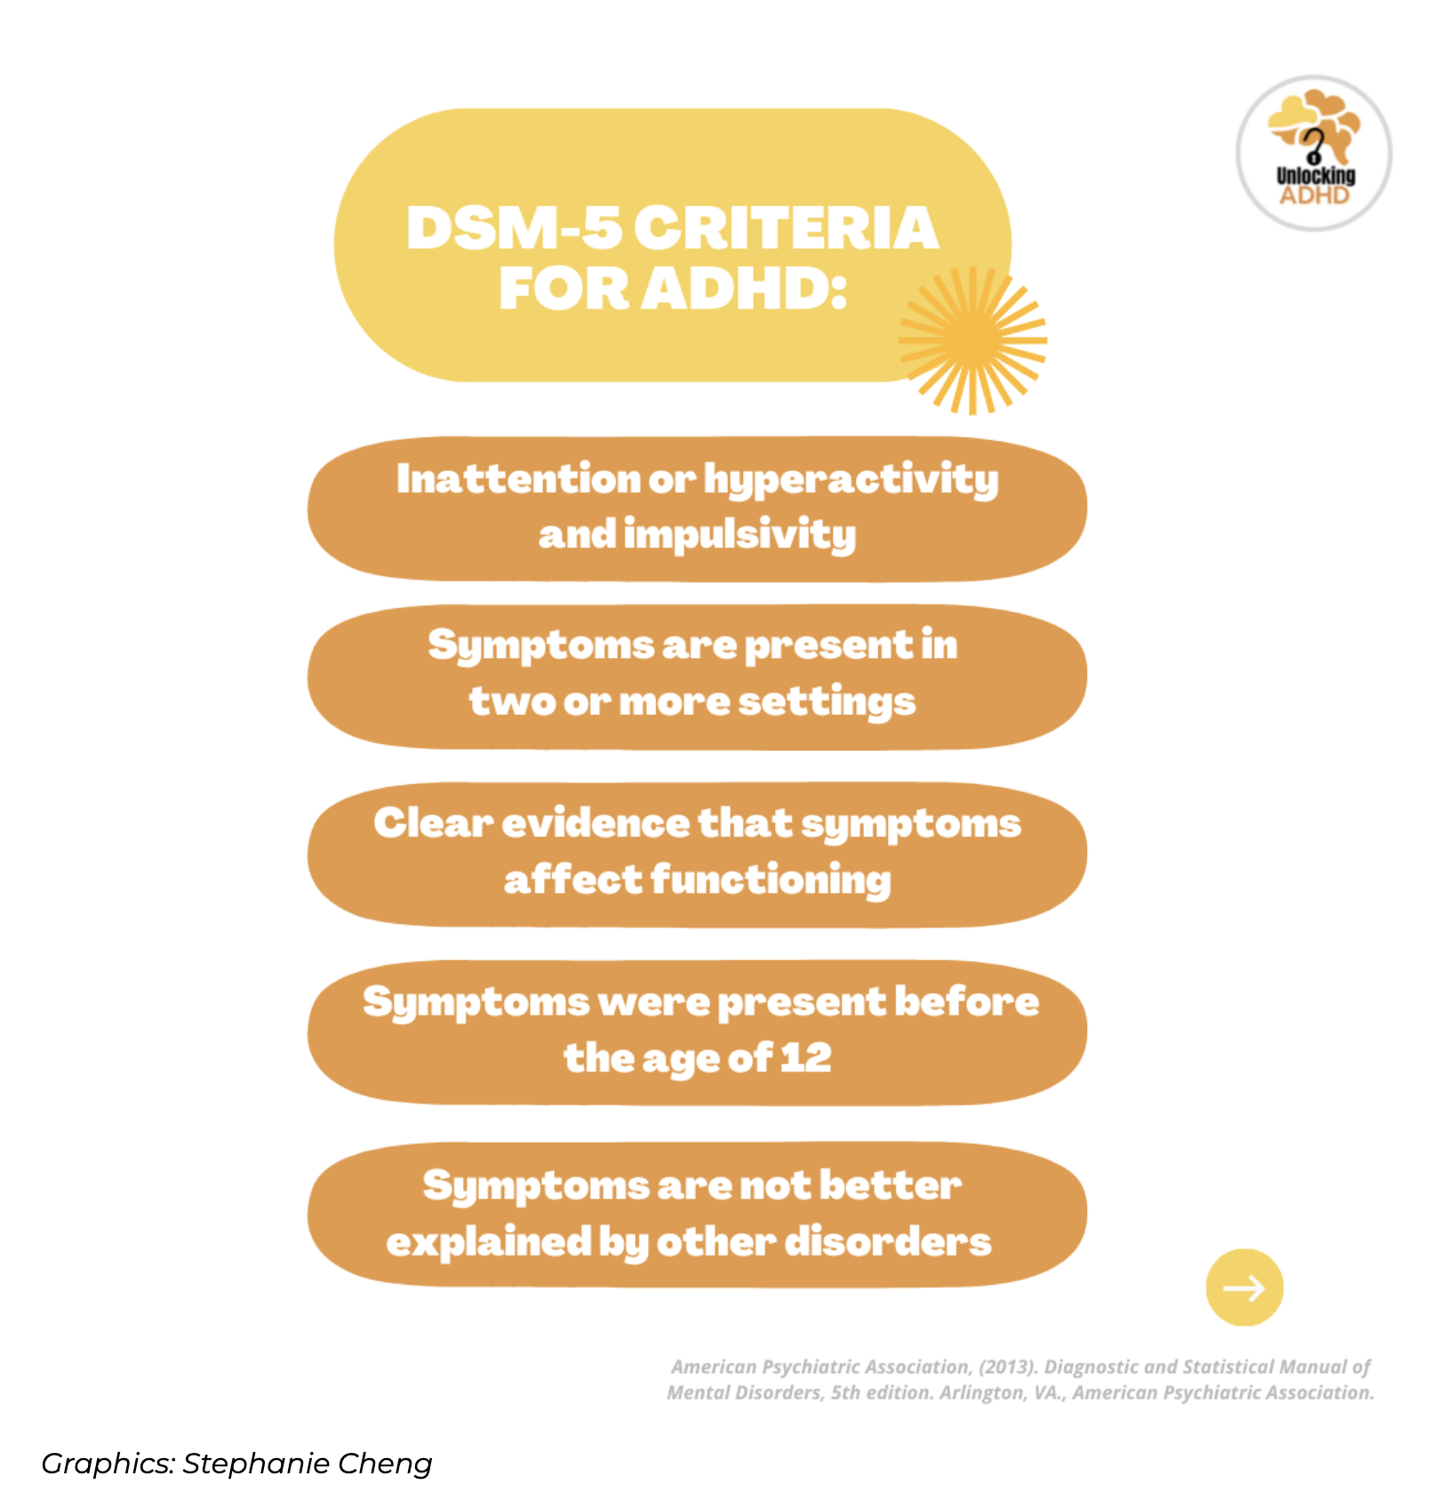
Notes:
Whilst everyone has aspects of ADHD-type behaviours (especially when we’re tired, anxious, emotional, overwhelmed…) you will only be diagnosed with ADHD if these symptoms significantly impair multiple aspects of your life (home, school, work) and have persisted for more than 6 months.
In kids where ADHD behaviours have suddenly appeared, it is worth treating this as a big red flag as Executive Functioning Difficulties (more on this later) can be the result of trauma and/or anxiety.

Slide 7
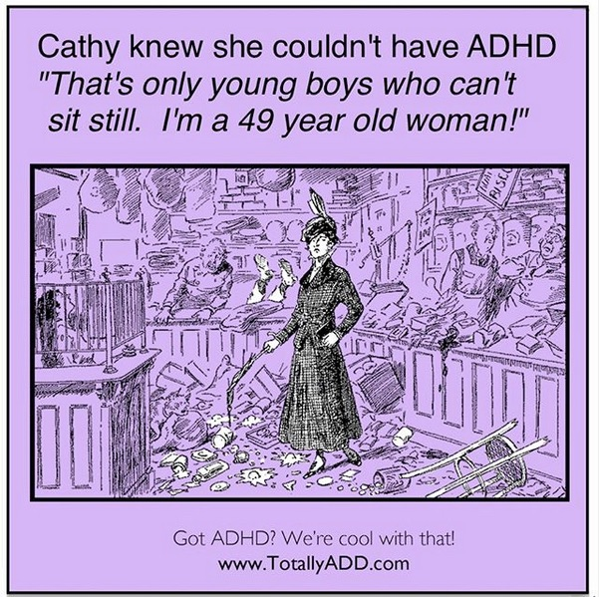
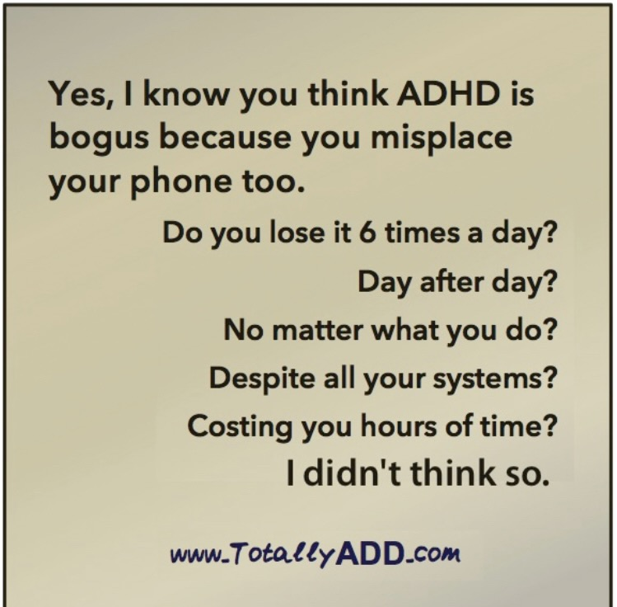
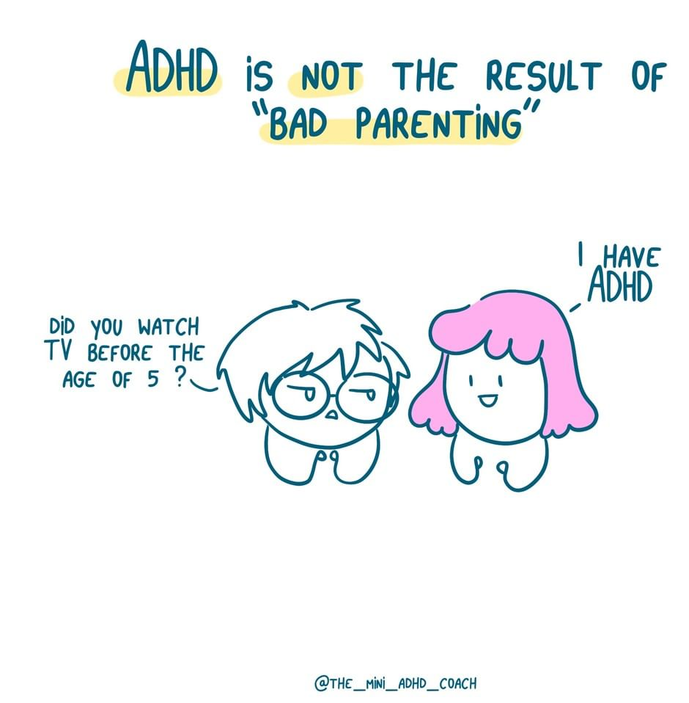
Myths and misconceptions
about ADHD
Notes:
There are a lot of challenges to understanding ADHD, particularly around misconceptions.
The Mini ADHD Coach addresses many of these here: https://www.theminiadhdcoach.com/adhd-awareness/what-adhd-is-not

Slide 8
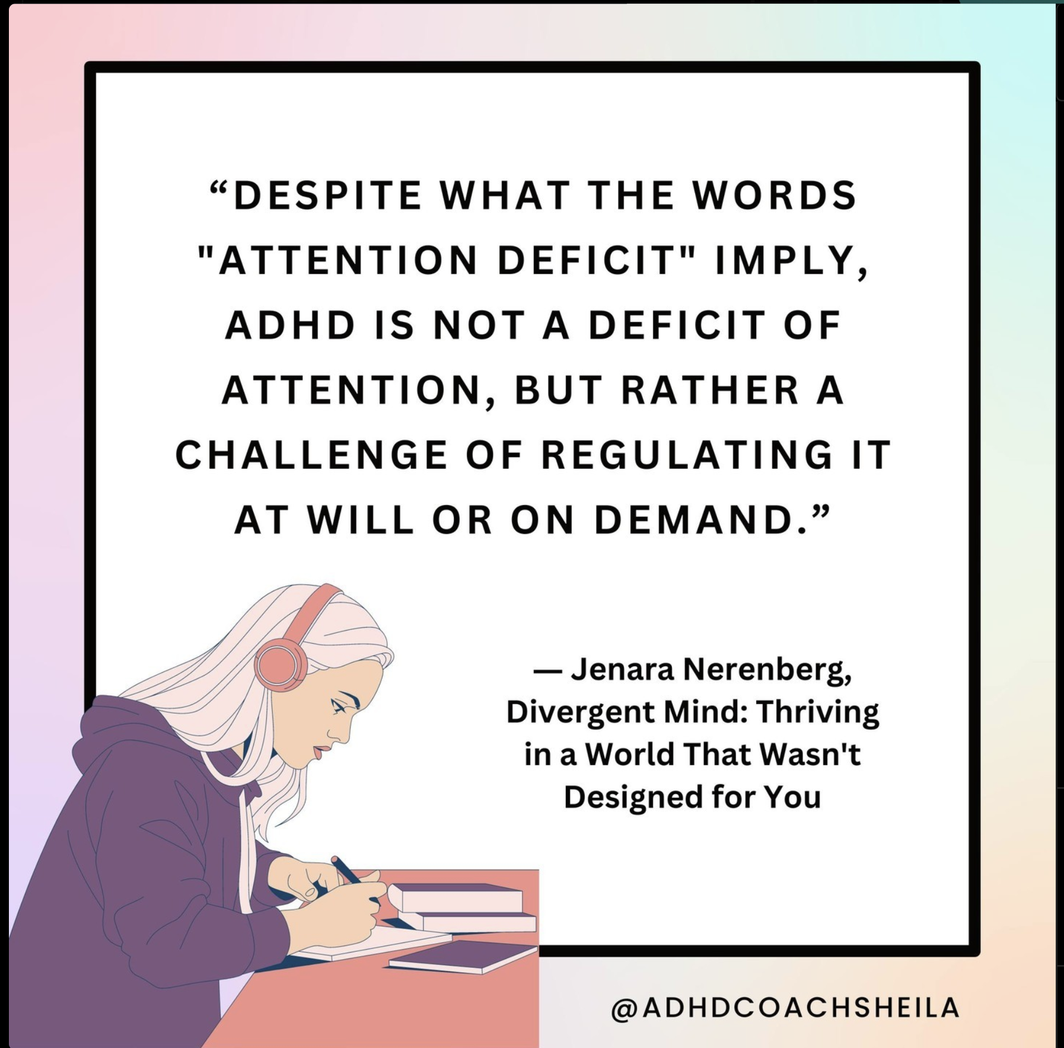
Notes:
Attention Deficit Hyperactivity Disorder is a complete misnomer- People with ADHD do NOT HAVE A deficit in attention, but rather struggle to regulate their attention. They cannot motivate themselves to engage in something just because “they should”. On the other hand, if something is interesting, they can hyperfocus to the exclusion of all other demands (eating, sleeping, family, homework, etc.)

Slide 9
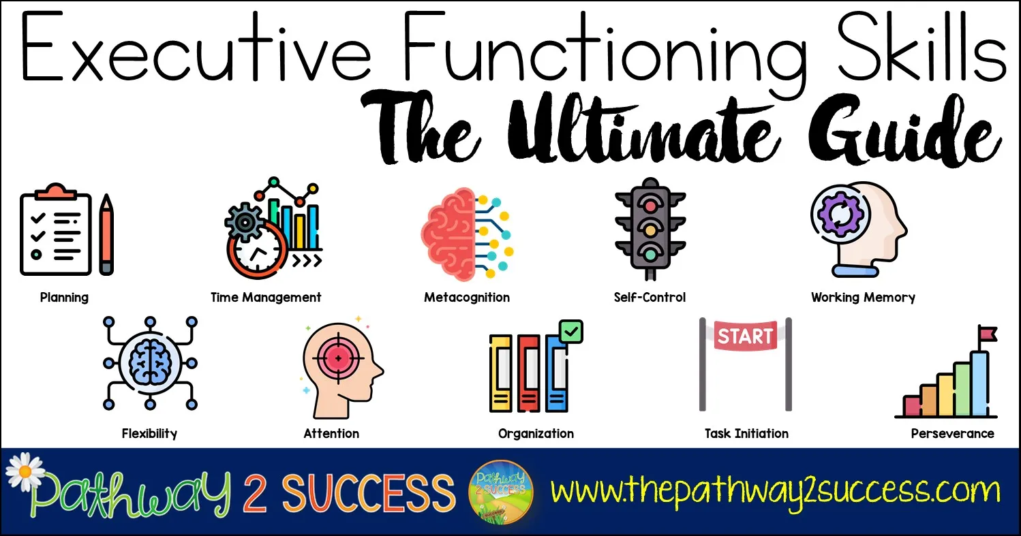
Notes:
At one point, ADHD was described as Executive Dysfunction and we know that this is certainly part of the story.
Executive functioning skills are those relating to planning and undertaking tasks.
Here is an excellent resource to use with children and young people with ADHD and also to share with their parents and carers:
https://www.chconline.org/resourcelibrary/executive-function-101-e-book-downloadable/

Slide 10
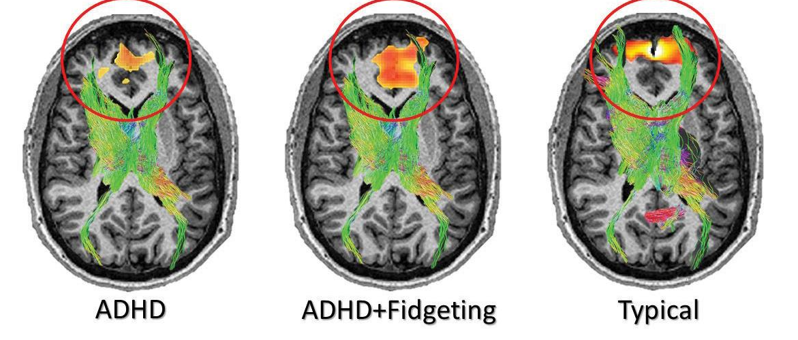
Brain imaging shows that fidgeting increases the blood flow to the prefrontal cortex - the part of the brain that is responsible for executive functioning and decision making.
(Fernandez, J., et al. 2021)

Slide 11
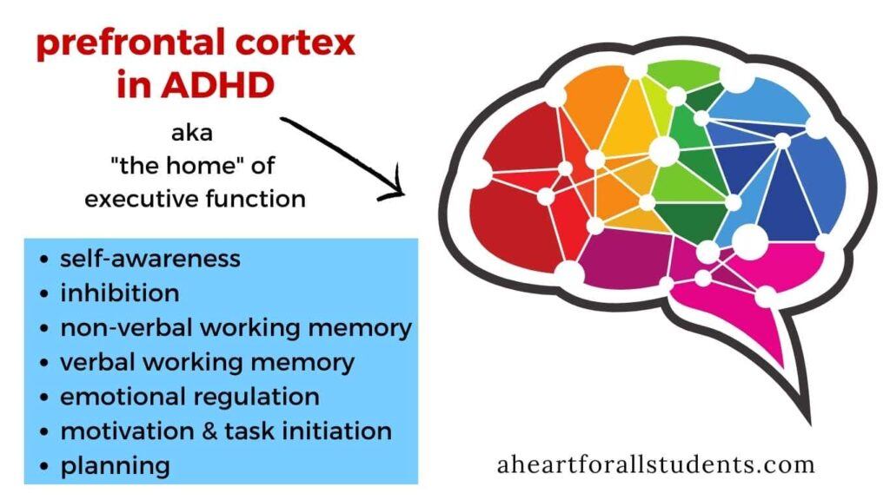
Notes:
People with ADHD have delayed frontal lobe development which means they struggle with executive functioning skills.
Briefly explain Dan Segal’s hand model https://www.youtube.com/watch?v=LdaUZ_wbD1c- people with ADHD, trauma and anxiety find it harder to stop themselves from “flipping their lids”. In these moments, they are not fully accessing their pre-frontal cortex and executive functioning goes out of the window ( for those who weren’t there, here’s Dan’s explanation of his hand model: https://www.youtube.com/watch?v=f-m2YcdMdFw ).
This model is a very useful way of supporting ADHDers with understanding some of their emotional responses and a step in the right direction with regards to teaching them how to manage them.

Slide 12
“Delayed frontal lobe development makes regulating the limbic system - the circuitry associated with emotion, anxiety, reward and risky behaviour- more difficult.”
Dr Timothy Wilens, M.D.
Notes:
Teenagers are already prone to engaging in risk-taking behaviours, but when we add in the delayed frontal lobe development and the associated executive function difficulties, our ADHD pupils are far less ABLE to think through their actions and less able to suppress their impulsivity.
One important neurotransmitter that impacts the prefrontal cortex is dopamine.

Slide 13
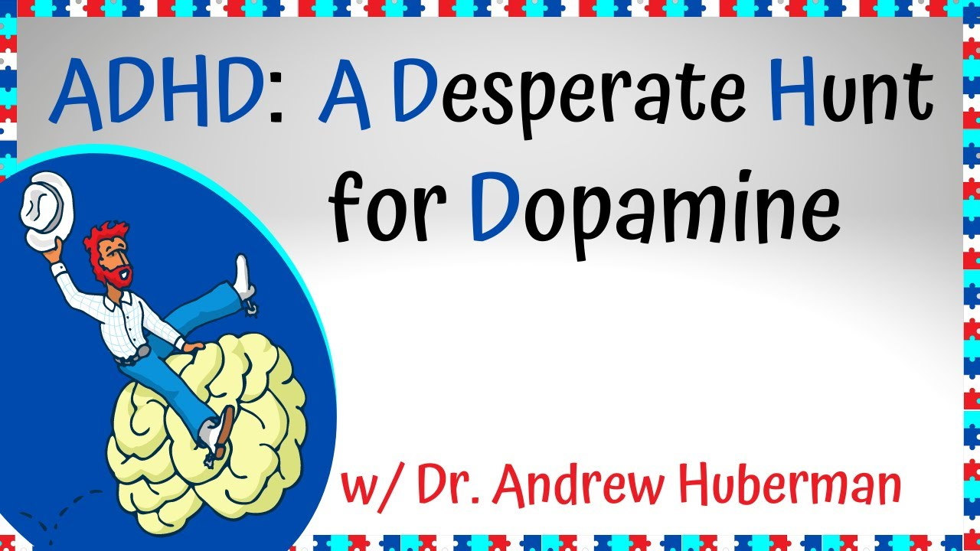
https://youtu.be/s_P6sNFjLzI
Notes:
Studies show high levels of dopamine transporters in people with ADHD.
These transporters clear away the dopamine before they can attach to the dopamine receptors.
This makes people with ADHD “chemically wired” to seek more dopamine.
Explain how Dopamine affects both the neurotypical and ADHD brain (or if you weren’t there, watch up to 2min 40 seconds on the video: )
How Dopamine Affects Learning and Motivation in ADHD Brains

Slide 14
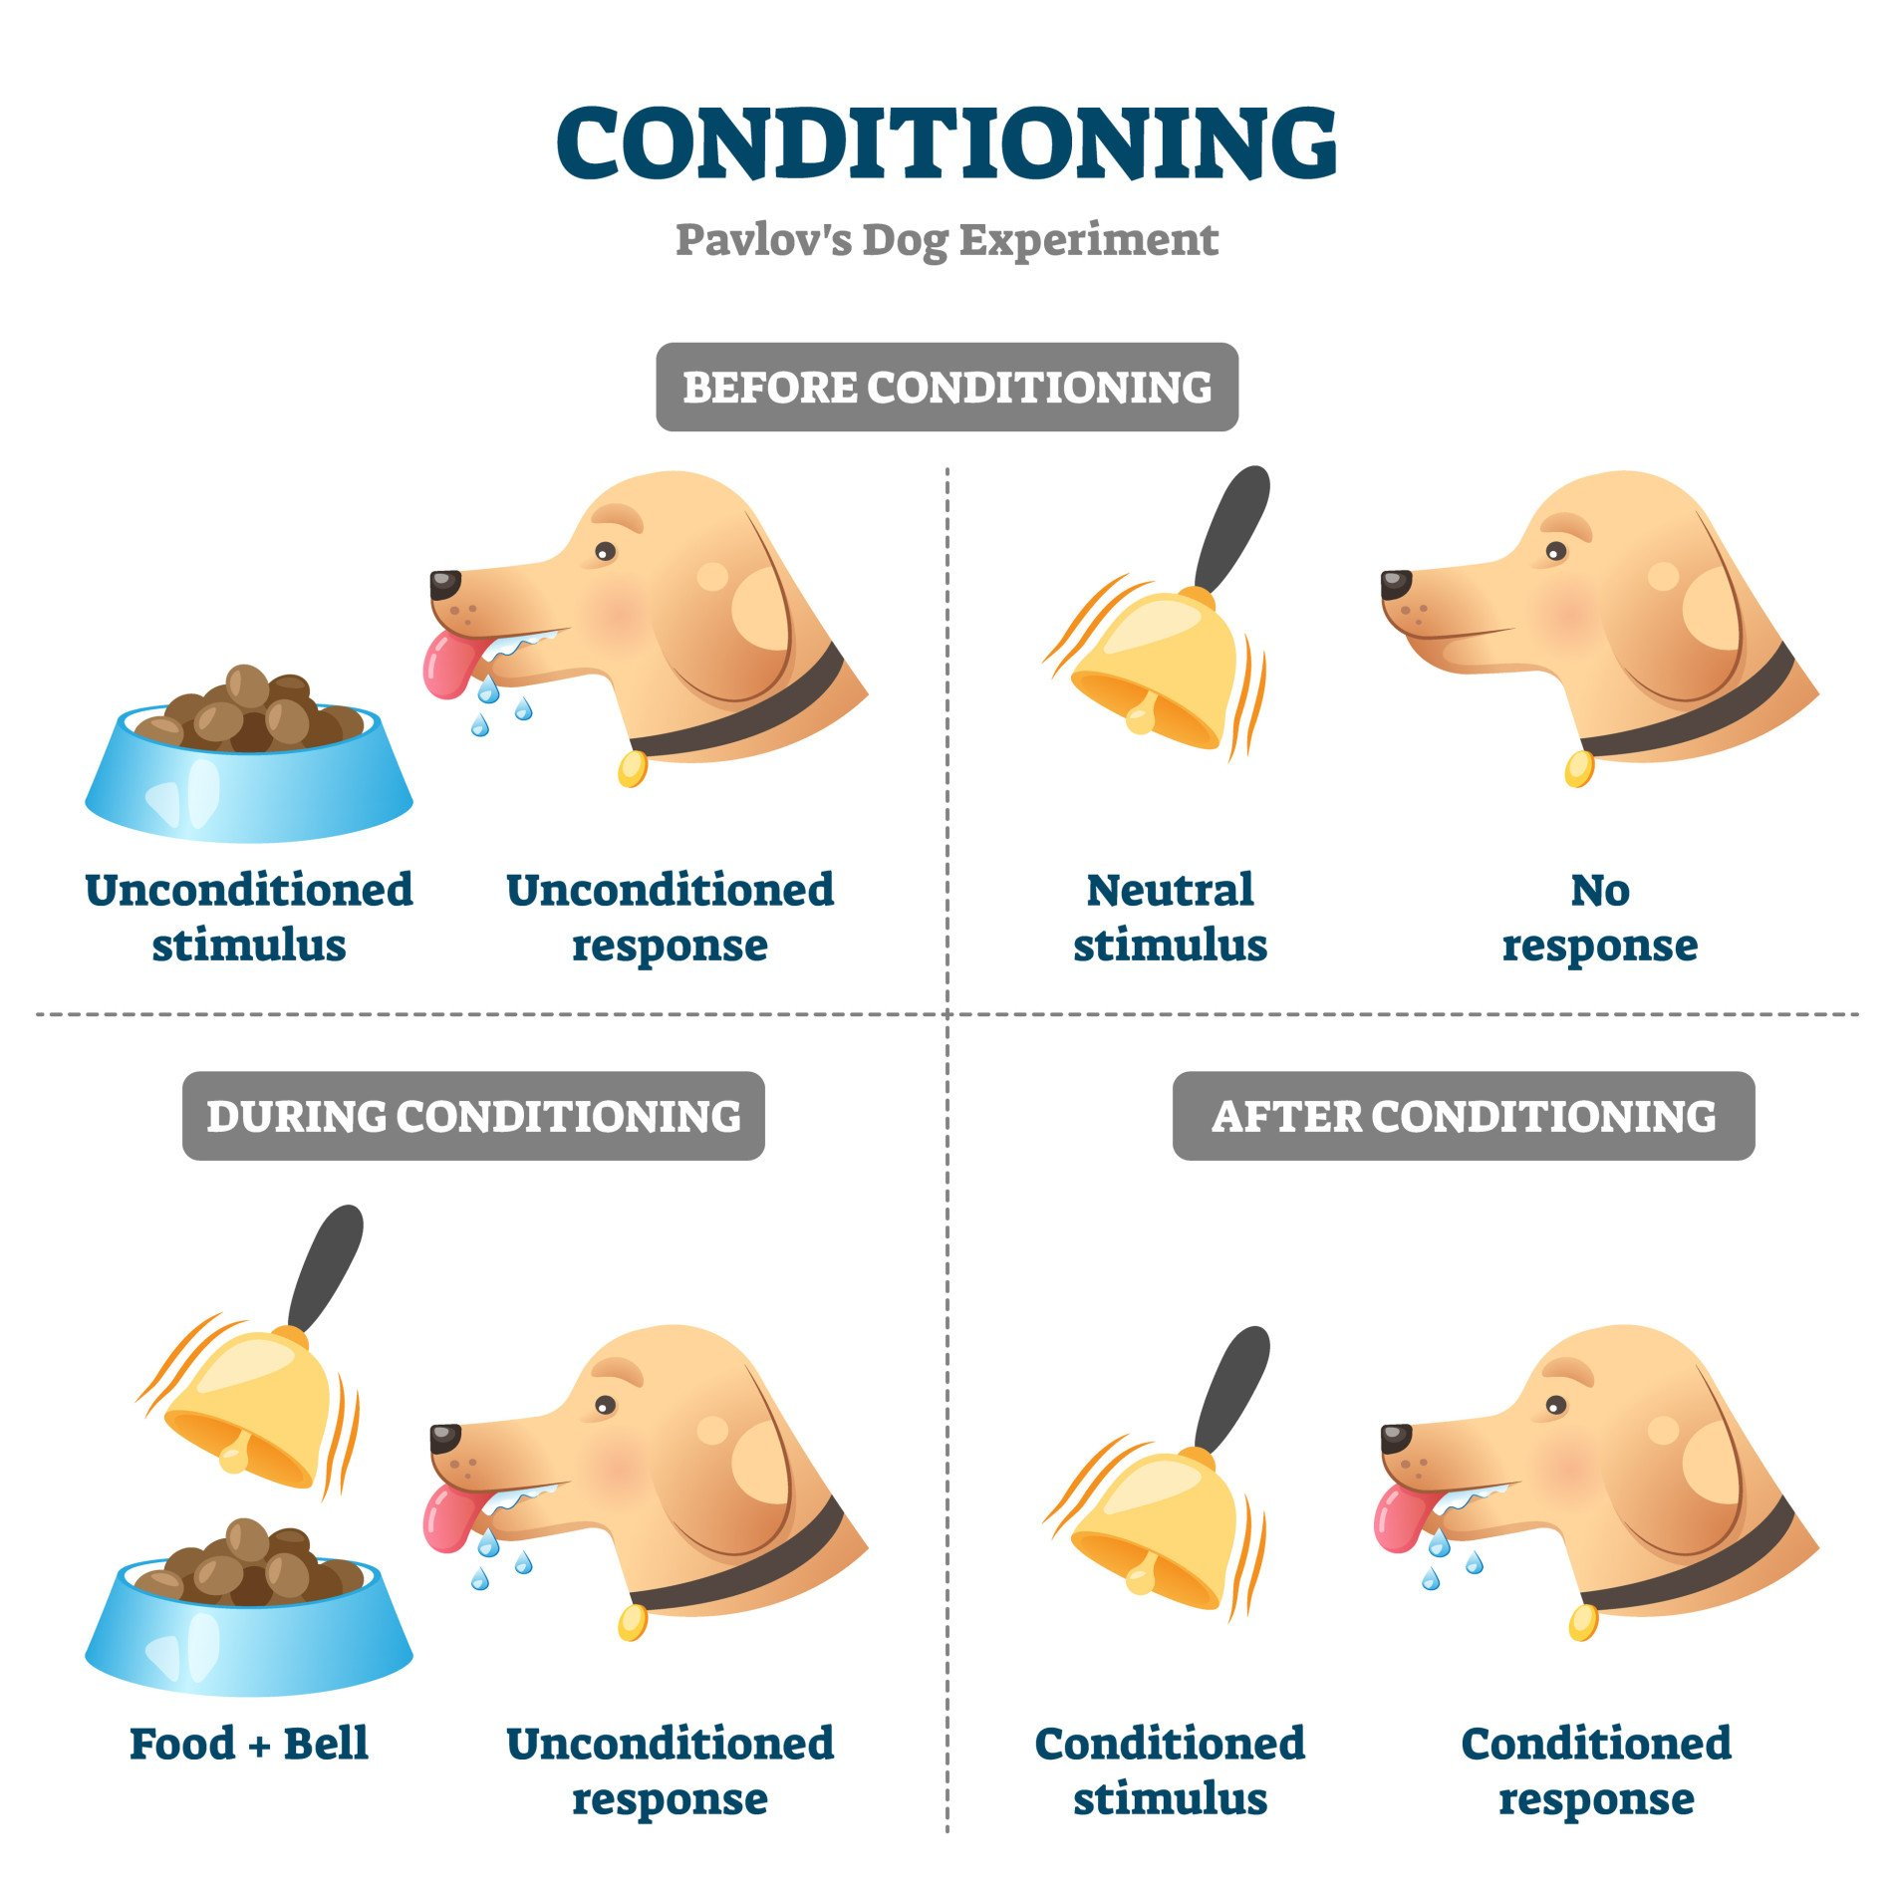
Releasing dopamine feels good because dopamine tells your brain that a “reward” is about to happen.
Notes:
Dopamine is supposed to lead you towards a positive and rewarding path in life.
Historically, dopamine has helped humans survive and thrive.
For example, in the 1500’s, if a man was hungry, he would probably feel compelled to venture into the woods and hunt an animal.
After hunting the animal and feeding his family, the hunter would probably feel very satisfied, and his brain would release dopamine.
Pretty simple stuff right?
Dopamine has been a positive indicator for most of human history.
Until now…

Slide 15
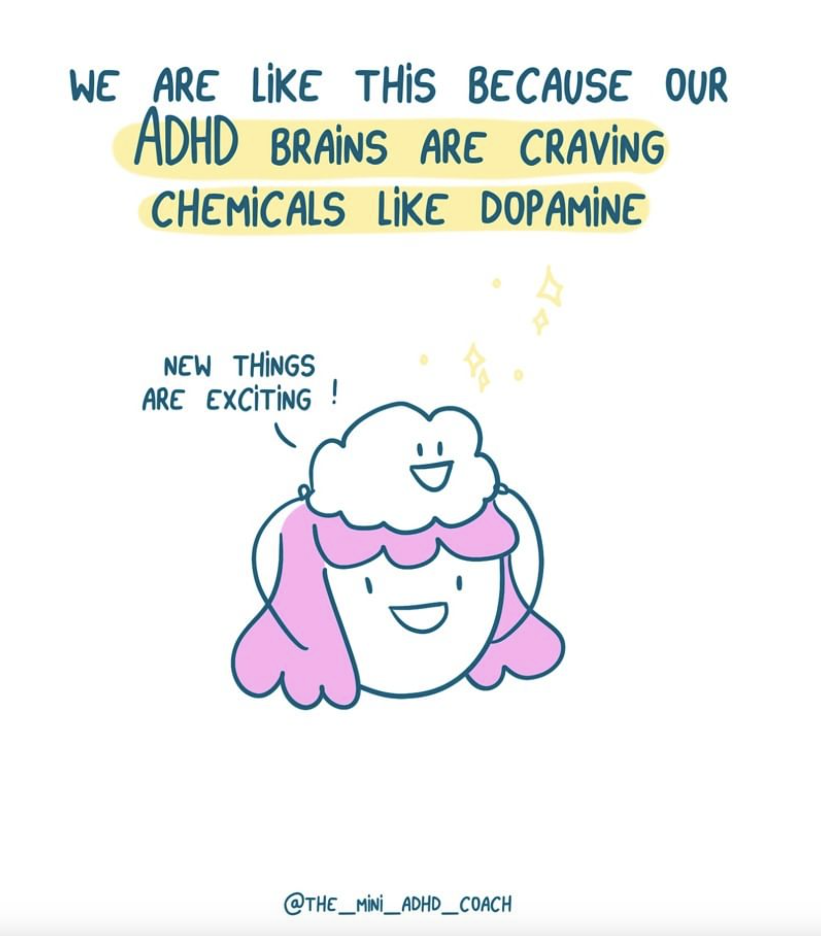
“Humans have never experienced this much dopamine before…
People with ADHD are always stimulated and excited about something new!
But… they can’t figure out which hits of dopamine to follow which makes them even more scatterbrained!”
The ADHD Boss

Slide 16
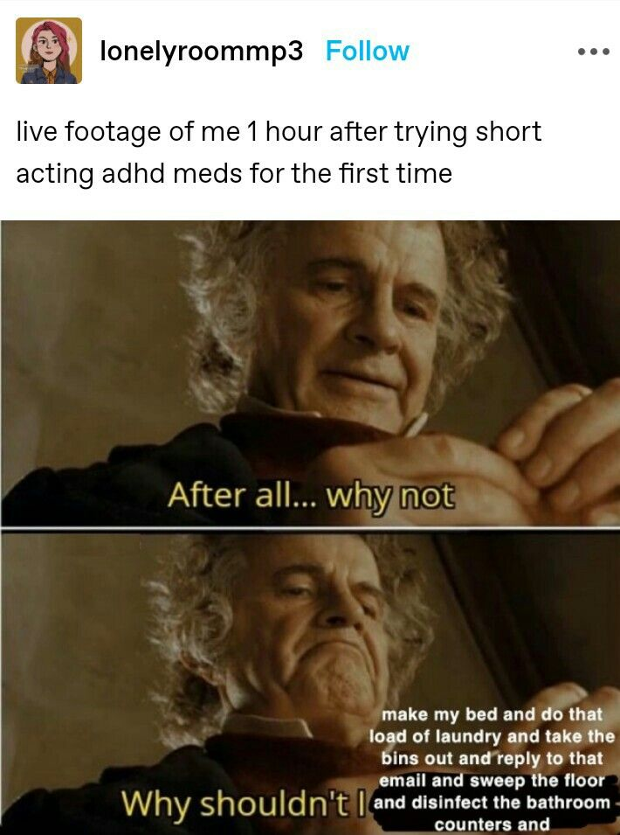
Stimulants
Believed to work by increasing dopamine and norepinephrine levels in the brain.
2 types:
Methylphenidates: block the reuptake of dopamine.
Amphetamines: block reuptake and stimulate additional release of dopamine
Notes:
Stimulants help people with ADHD become better at observing and regulating their behaviours.
Methylphenicates - Ritalin and Concerta- block dopamine reuptake so that it stays in the synapse between neurons for longer and therefore activates them more.
Amphetamines- Adderall and Vyvanse
It not only reduces the “desperate hunt for dopamine” in the moment, it also sustains motivation so that a task can be completed.

Slide 17
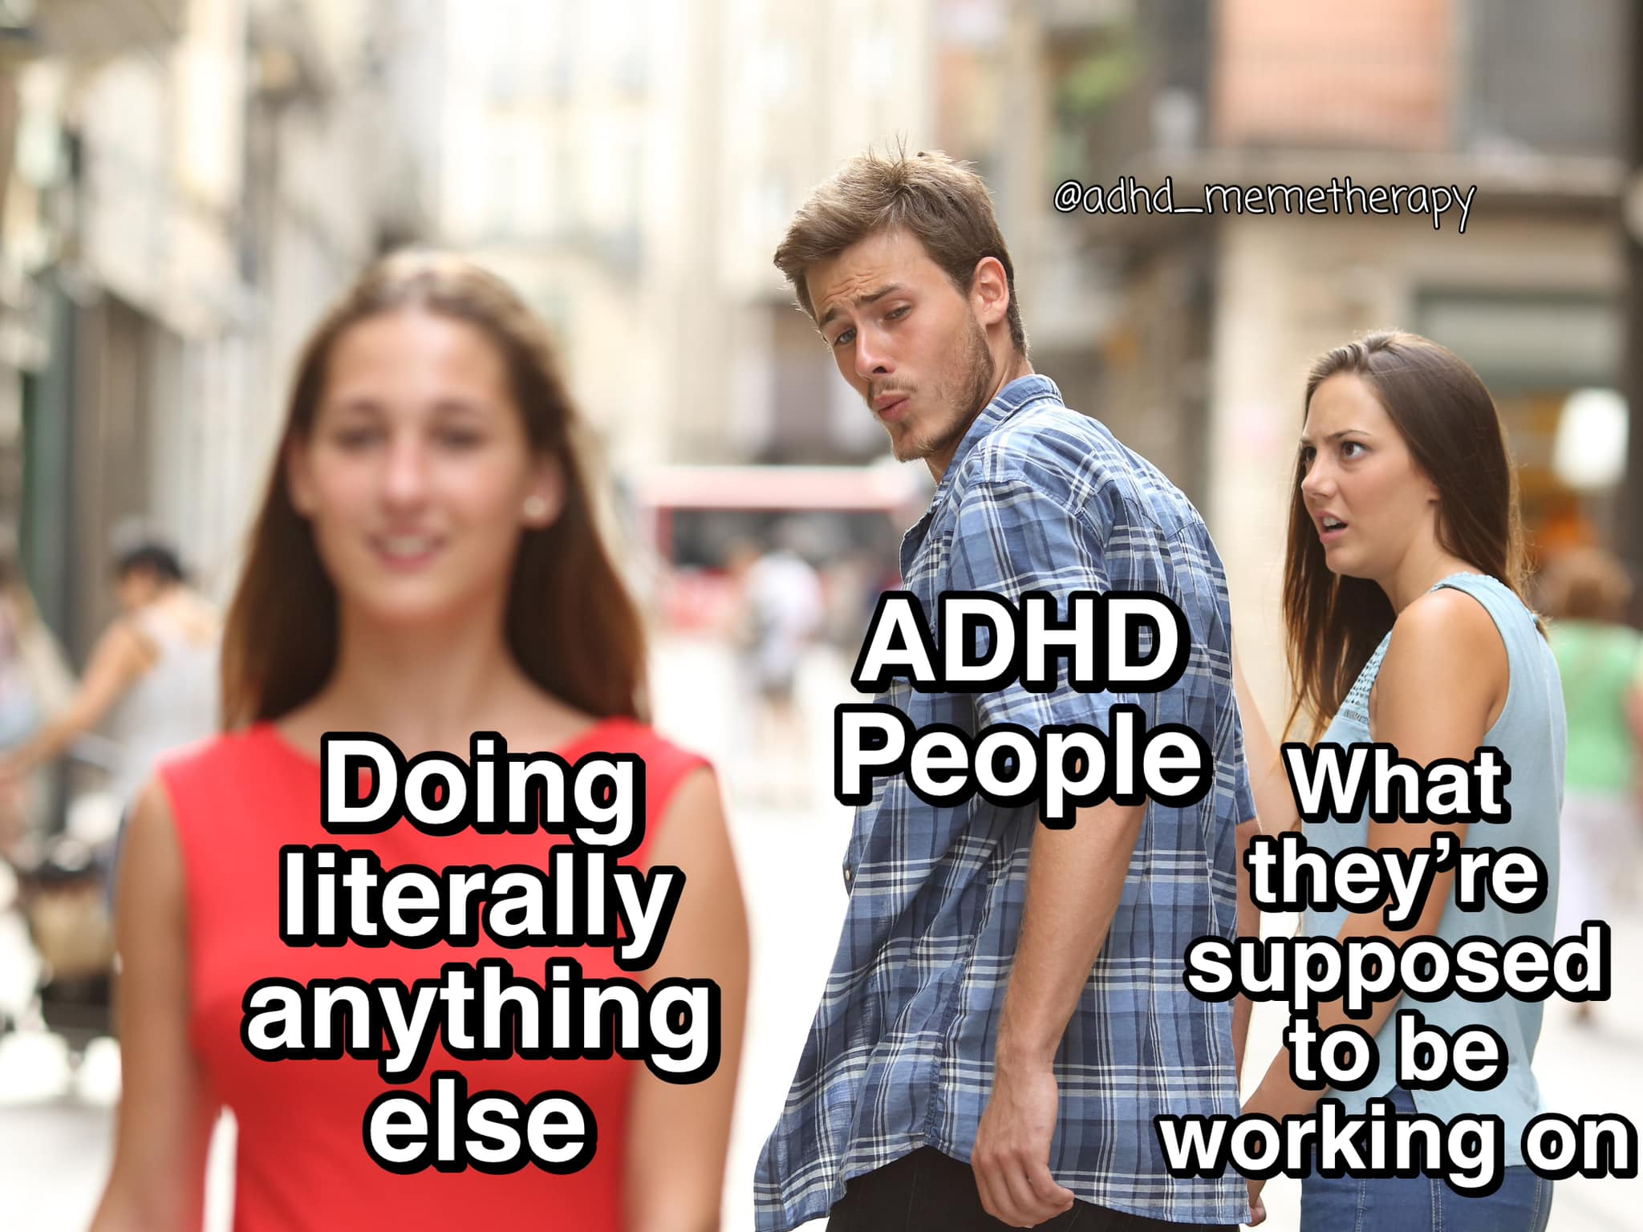
Productive Procrastination
A.k.a. Side Quests
https://www.instagram.com/reel/CqJGRccvduI/?igshid=MTc4MmM1YmI2Ng%3D%3D
https://www.youtube.com/watch?v=AbSehcT19u0

Slide 18
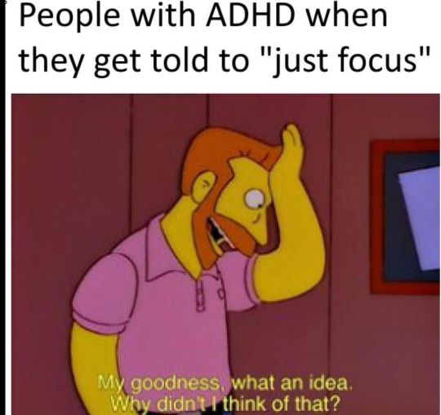
ADHD has little or nothing to do with EFFORT, DISCIPLINE or INTENTION.
It’s like telling a short sighted person to just try looking harder.
Notes:
These neurological differences mean that difficulties associated with ADHD have little or nothing to do with effort, discipline or intention.

Slide 19
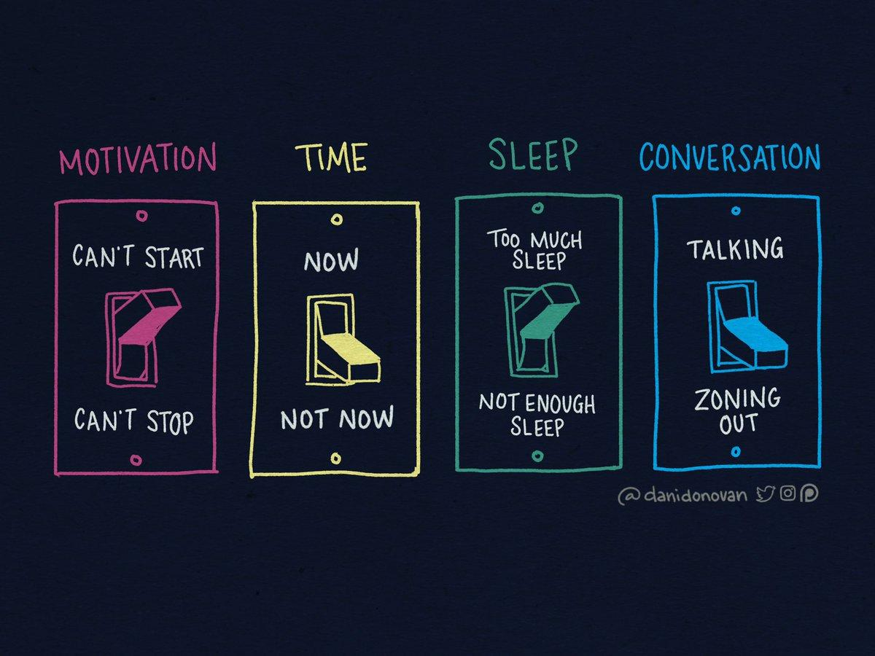
All or Nothing Thinking
https://www.tiktok.com/@connordewolfe/video/7130652050500750634?lang=en
https://www.tiktok.com/@em.raeburn/video/7219640343715794182?lang=en
There is no in between…
Notes:
Talk about examples
People with ADHD often struggle to get started on a boring task (this can be related to anxiety around knowing how to get started), but once they get into a rhythm, they find it very difficult to stop- task initiation and switching between tasks are elements of Executive Function.
Mention Time blindness (more on this later) and give examples of how people with ADHD are more likely to do a task that needs to be done- right now, whereas anything that can be done later will be shelved and often disappears from their minds completely.
Sleep examples
Conversation: https://www.facebook.com/adhdactually/photos/a.116338093248247/138207064394683/?type=3
If a student with ADHD is asking questions in class it is a good thing (especially in girls) as the alternative is that they have likely completely zoned out and are running through other things in their minds.

Slide 20
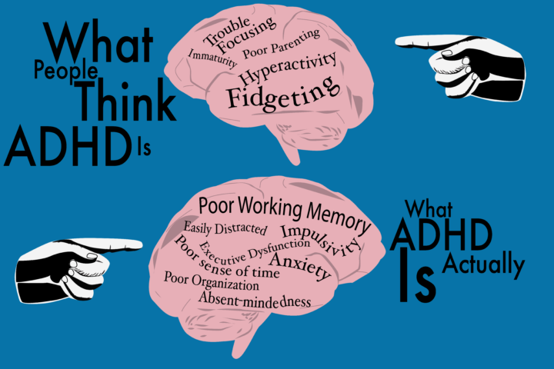
Let’s summarise!
ADHD Brain is wired differently
Executive Function differences
Chase dopamine
Can’t regulate attention
All or Nothing
https://www.tiktok.com/@connordewolfe/video/7219769711406615854
DAVE Youtube

Slide 21
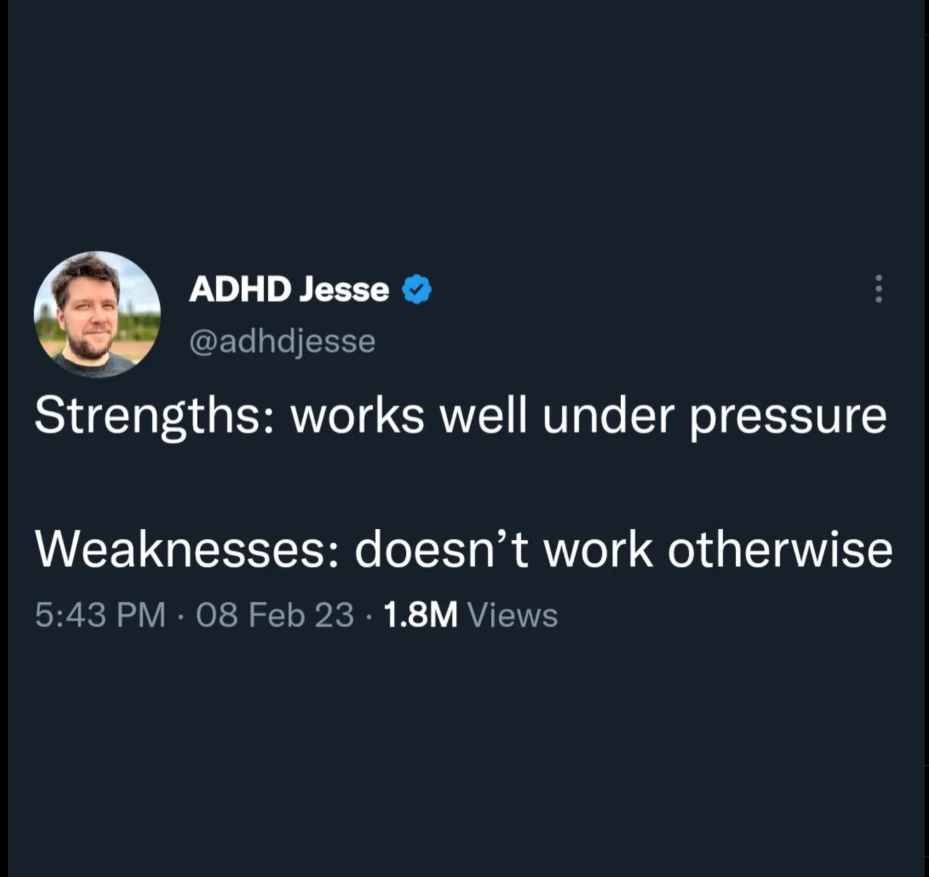
GETTING ORGANISED! #adhd #adhdtiktok #adhdawareness #adhdinwomen #adhd... | TikTok
For some ADHDers, anxiety associated with a deadline can drive them towards greatness…
For others, the anxiety can be completely debilitating…

Slide 22

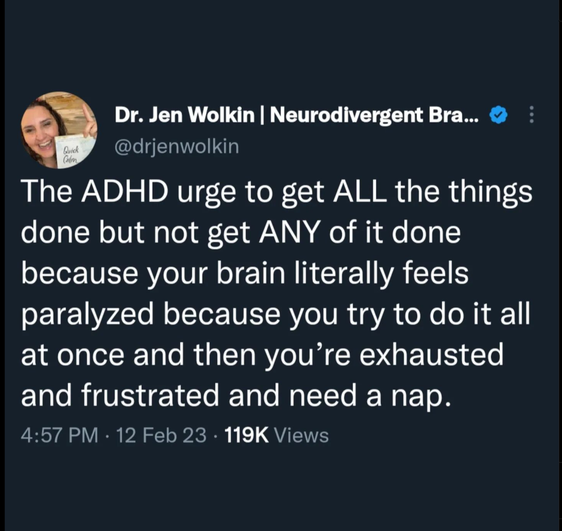
Notes:
Anxiety disorder is ADHD’s most common comorbid diagnosis with adult ADHD (simultaneously occurring conditions)
In one study on adults with ADHD, researchers noted that problems stemming from ADHD, such as being late, procrastination, and the prospect of social stigma, all led participants to experience anxiety at many points in their lives, “and once they were anxious, their ADHD symptoms worsened.”
- J Russell Ramsey PHD

Slide 23
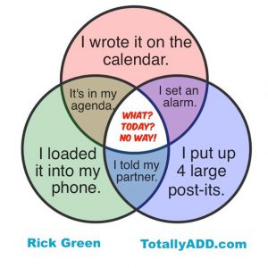
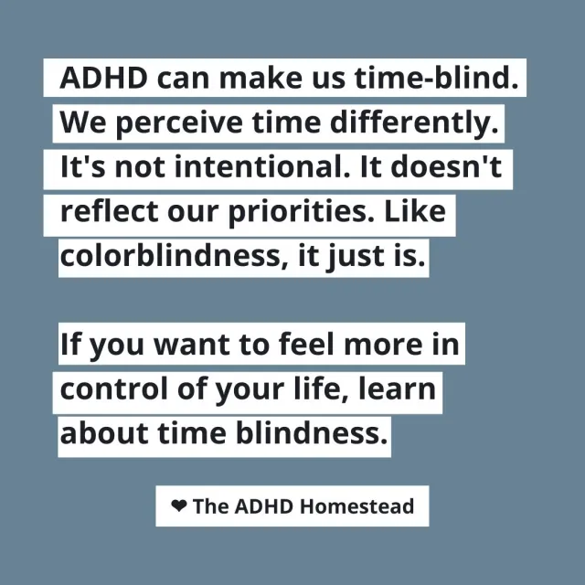
The ADHD phenomenons of
‘Time blindness’ - much weaker perception of time
‘Out of sight out of mind’ - object permanence
Notes:
A very common (also annoying and distressing) element of ADHD is 'time blindness'.
Adults with ADHD often have a weaker perception of time and it has been proposed that this symptom is a possible diagnostic characteristic.
'Time blindness' means that ADHDers can’t really tell you if something was last week or 3 months ago. They also don’t experience the passage of time in the same way as neurotypicals, and so are usually late, or way too early.
Sometimes being early is a strategy they use to avoid the anxiety associated with being late.
But also, remember that for ADHDers boredom can feel excruciating, so they will avoid being early as they hate having to wait.
Neurotypical organisation strategies don’t work for ADHDers, because once that planner or timetable is out of sight, it is instantly out of mind. (6 tips for teens and adults for managing this: https://www.choosingtherapy.com/object-permanence-adhd/ )

Slide 24
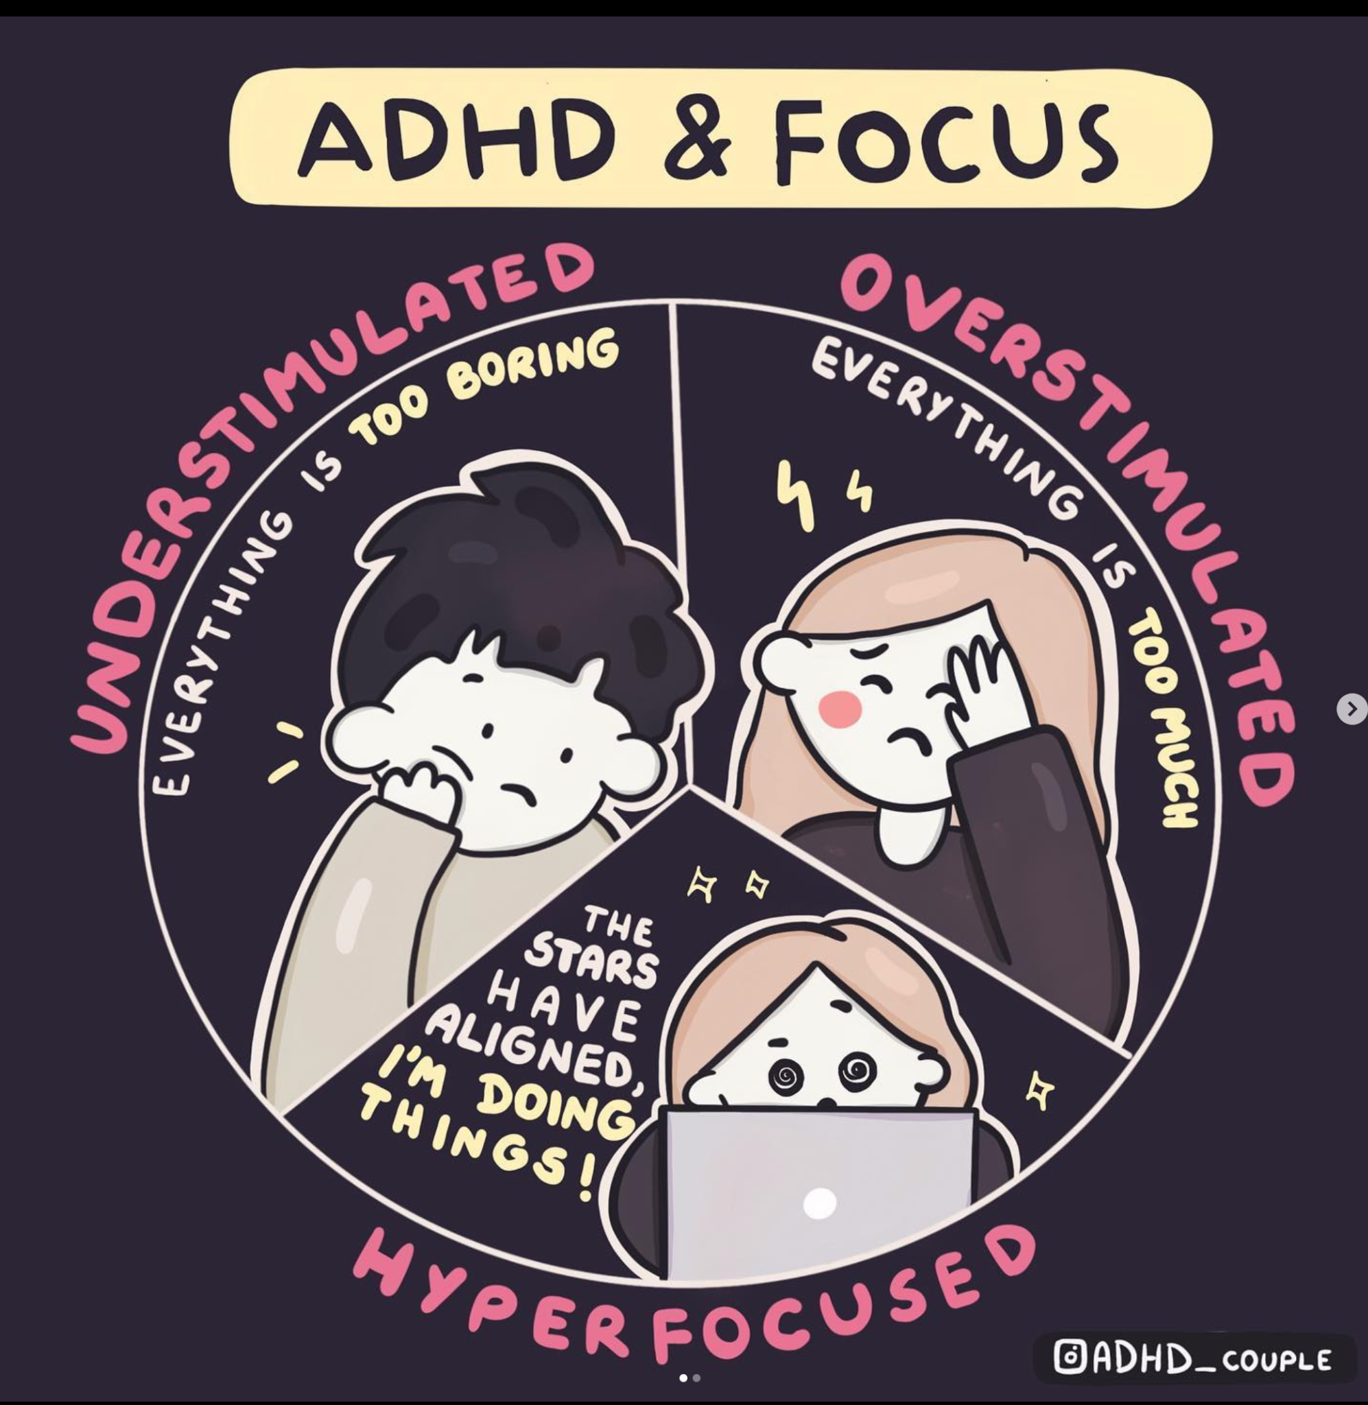
“Regulating attention is one of the key issues for ADHD brains.
Not being able to focus on what we want in that moment is a struggle.
And sometimes we get soooo focused that nothing or no one can remove us from the activity. And this can be a struggle too. 😅”
ADHD_Couple

Slide 25
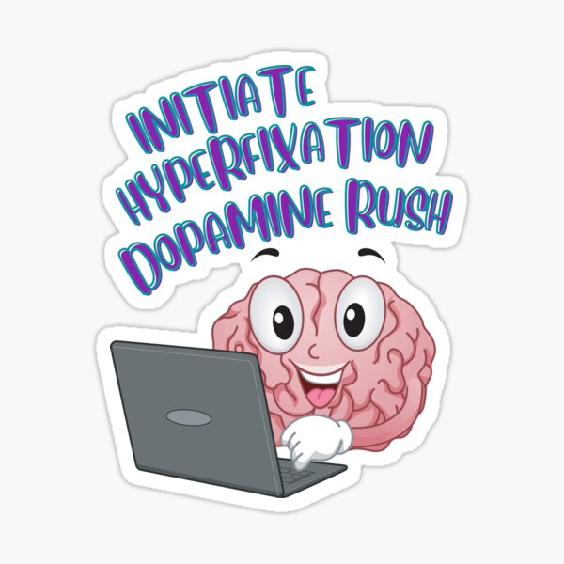
Hyperfocus
In the zone
Flow
ADHD superpower!
https://www.tiktok.com/@connordewolfe/video/7190890723842149678
…and then its over.
Notes:
Hyperfixation is complete absorption in a task, to a point where a person appears to completely ignore or ‘tune out’ everything else.
An example of hyperfixation is when a child becomes engrossed in a video game to a point where they do not hear a parent calling their name.
Hyperfixation is characterized by:
An intense state of concentration and focus.
Awareness of things not related to the current focus not even consciously noticed.
Hyperfixation is usually dedicated to things that the person finds enjoyable or fascinating.
During a hyperfixation state, task performance improves.

Slide 26
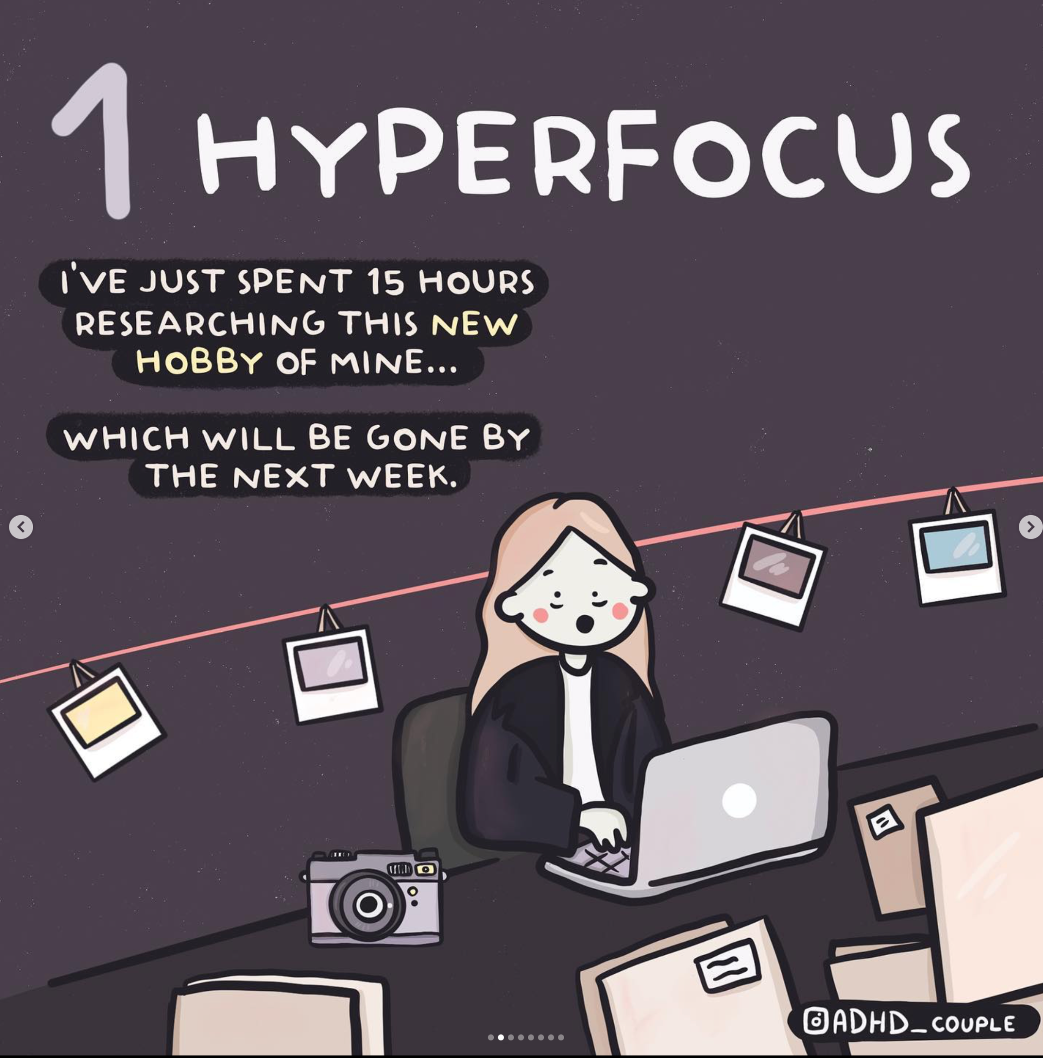
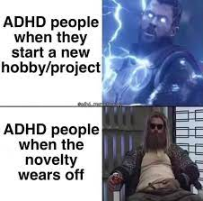

Slide 27
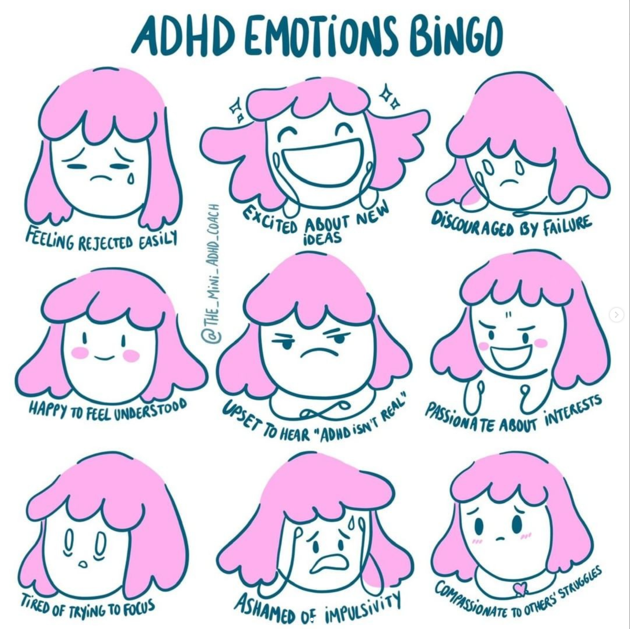
ADHD and Emotion Dysregulation
Notes:
“Emotion regulation is a big part of ADHD that has been traditionally ignored,” says Joel Nigg, Ph.D. “When comparing ADHD brains to those without, we see that the connection between the prefrontal cortex and the reward system has reduced activation, especially in the dorsal part of the prefrontal cortex. This could explain overexcitement, frustration & anger, and inability to respond to delayed rewards.”
ADHDer are often highly sensitive people, which meant they are more empathic and in tune with people’s feelings. On the other hand it can mean you feel a deep sense of sadness and rejection when you think that you’ve let others down.

Slide 28
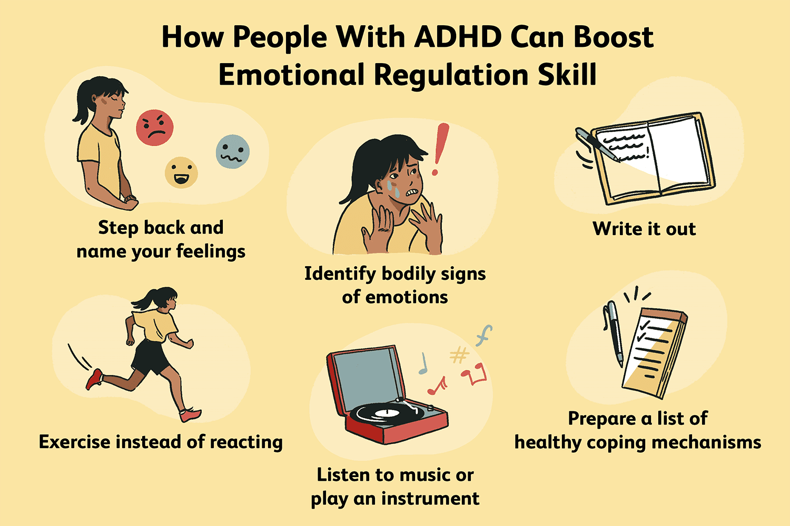
Emotion Regulation tools and strategies are the most effective treatment for people with ADHD.
(Van der Oord and Tripp, 2020)
Notes:
Punishment is not an effective tool for managing ADHD
People with ADHD require emotional regulation tools and strategies
We could do a WHOLE DAY of training on emotion regulation…. But here’s a good starting point:
aheartforallstudents.com/emotional-regulation-activities-for-kids/

Slide 29
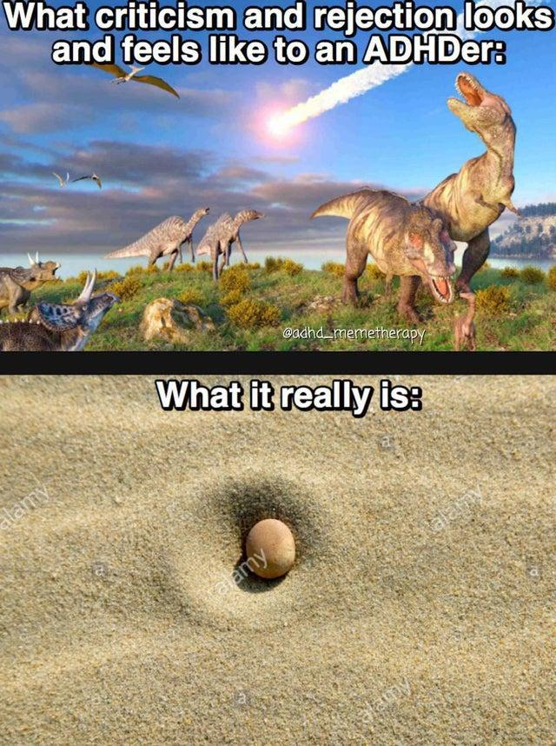
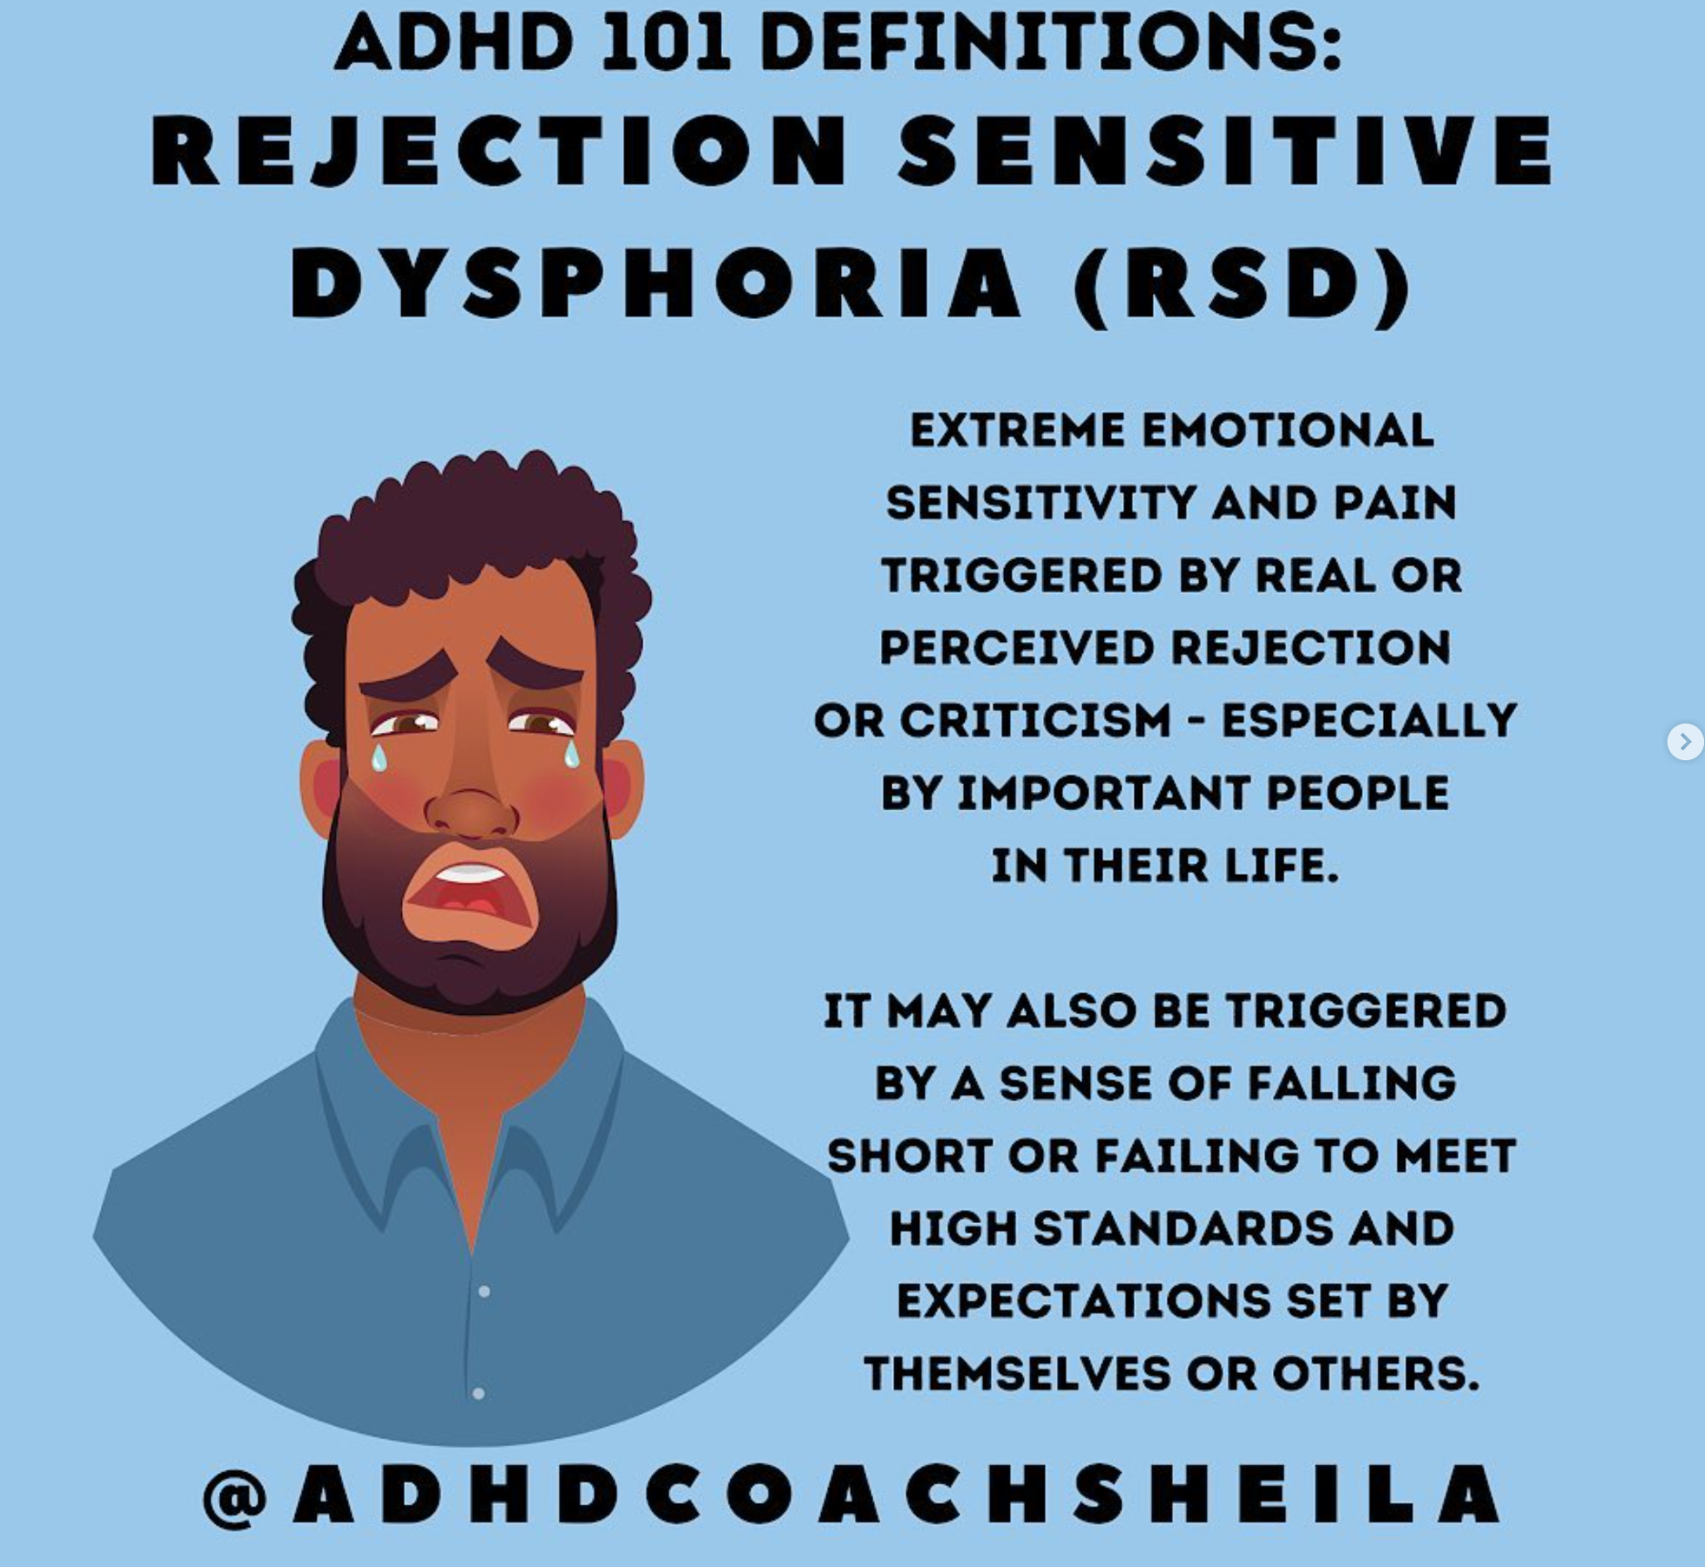
Notes:
For people with RSD, emotions are powerful and swift. The sudden shift in moods is overwhelming,

Slide 30
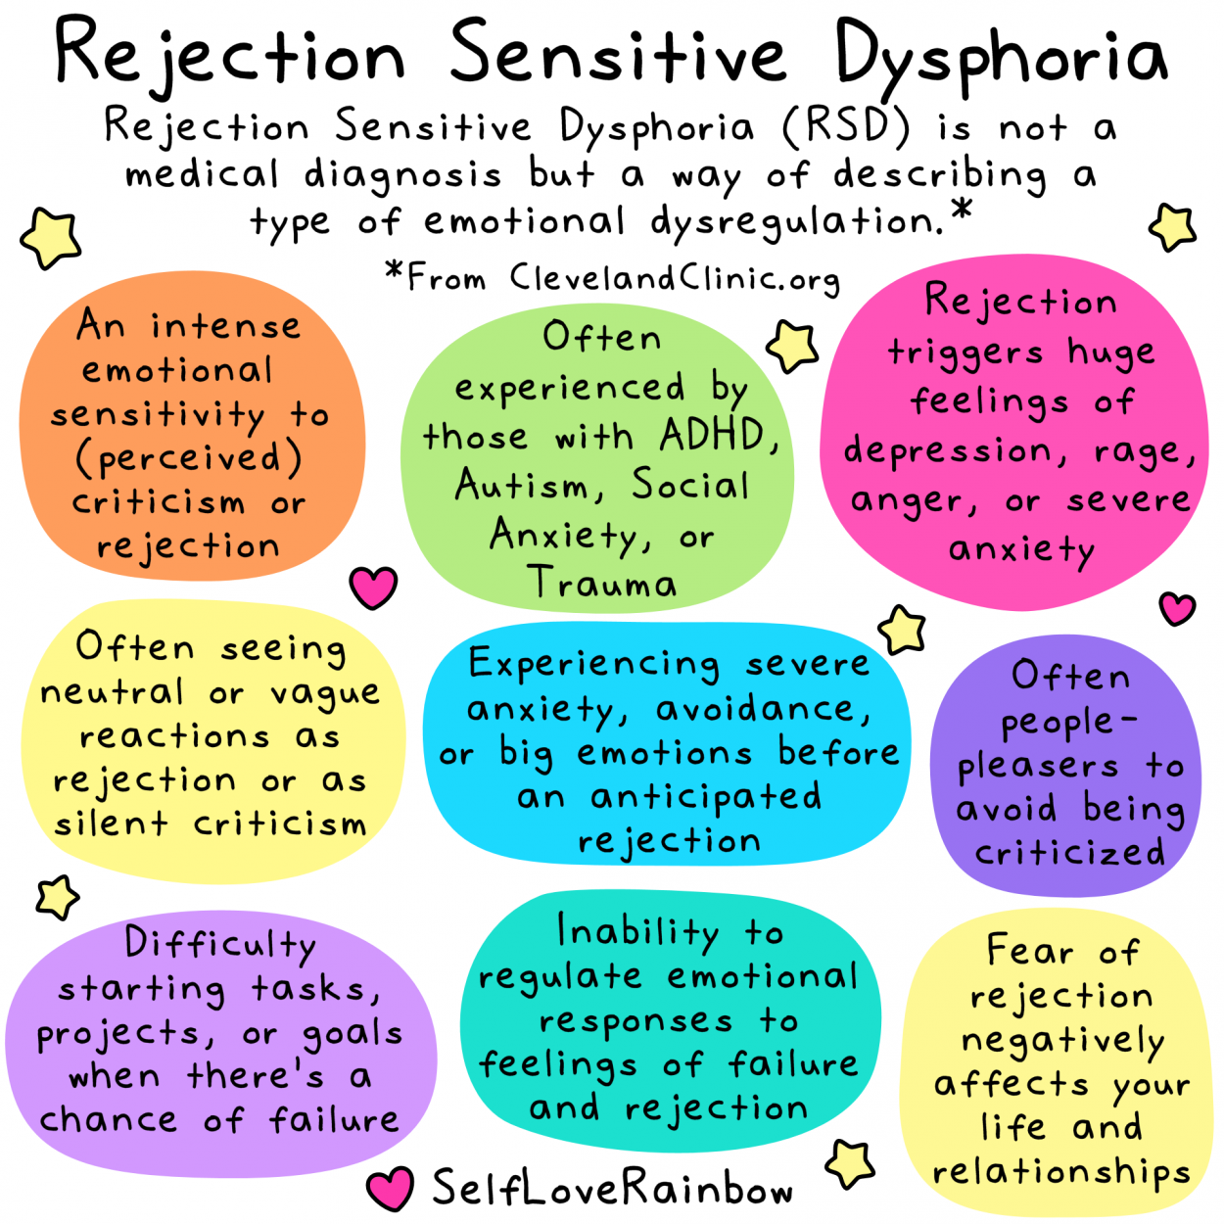
https://www.facebook.com/100064378620363/videos/870909007333765?__so__=permalink

Slide 31
In conclusion
ADHD symptoms relate to differences in the prefrontal cortex which deals with Executive Functioning and with the amounts of dopamine in the brain.
ADHD affects the regulation of attention (rather than indicating a deficit).
ADHDers “chase the Dopamine”, such as eating carbs, novel experiences, exercise and in some cases risky behaviours, especially in teens.
Boredom and Rejection cause ADHDers to experience pain and anxiety.
When these differences are harnessed, the potential is extraordinary…

Slide 32
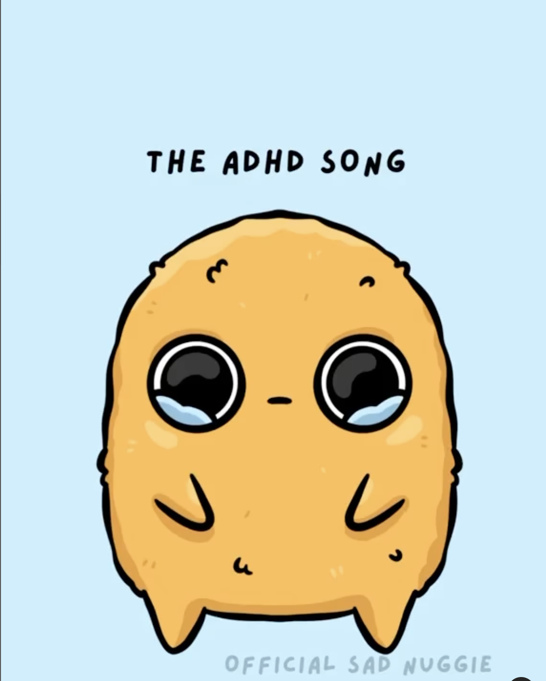
To summarise…
https://www.instagram.com/p/Cvu97wWMrID/

